Slide 1
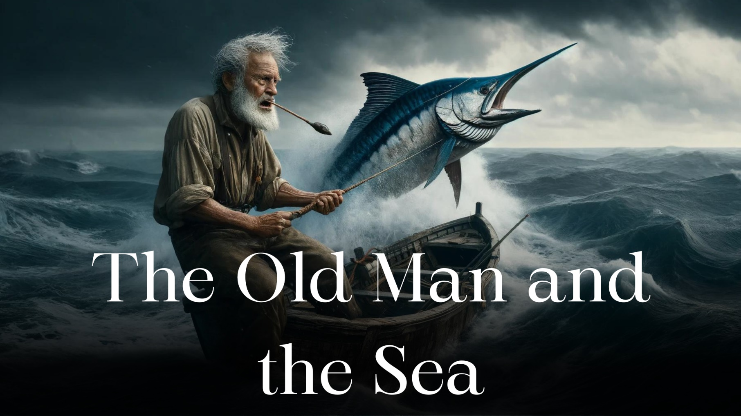
Presented by
Name: Naimur Rahman Tareq
Reg. 2020236010
Tittle: Santiago’s perseverance and Strength

Slide 2
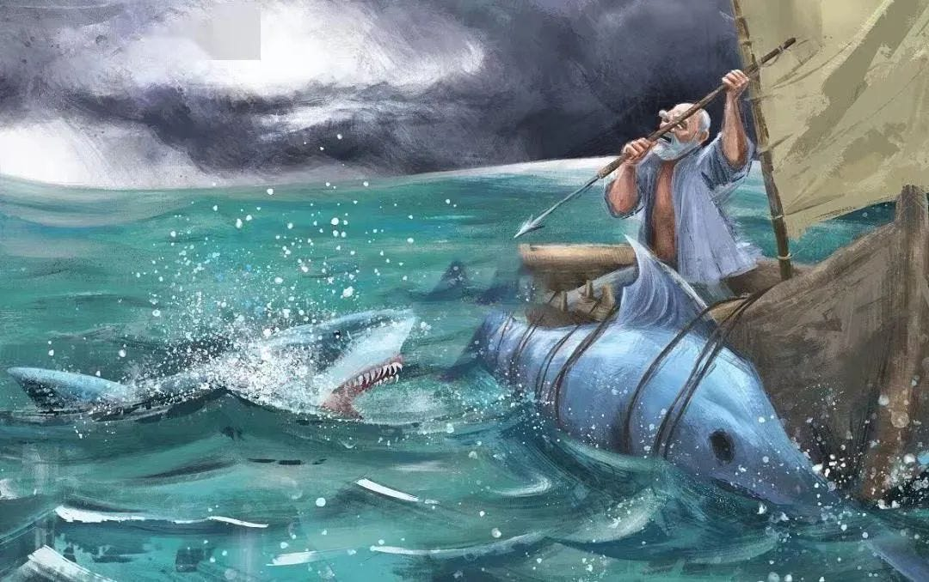
~Physical Strength
🩸 Holds the fishing line for hours, enduring
pain and exhaustion.
🩸 Fights off sharks to protect his catch
~Mental Strength
🩸 Believes in himself and his abilities.
🩸 Faces loneliness and struggle.
“A man can be destroyed but not defeated”
Santiago’s Strength

Slide 3
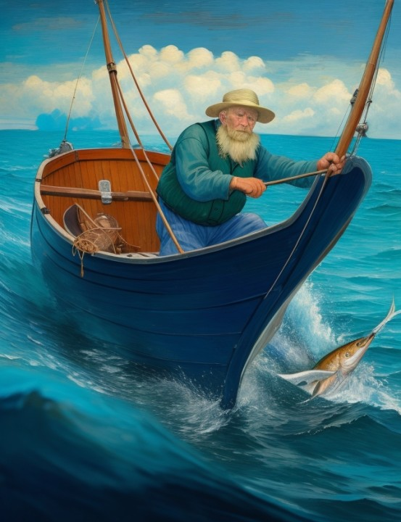
➤ The Battle with the Marlin
➤ The Shark’s Attack
➤ Returning Home
Key Moments of Perseverance

Slide 4

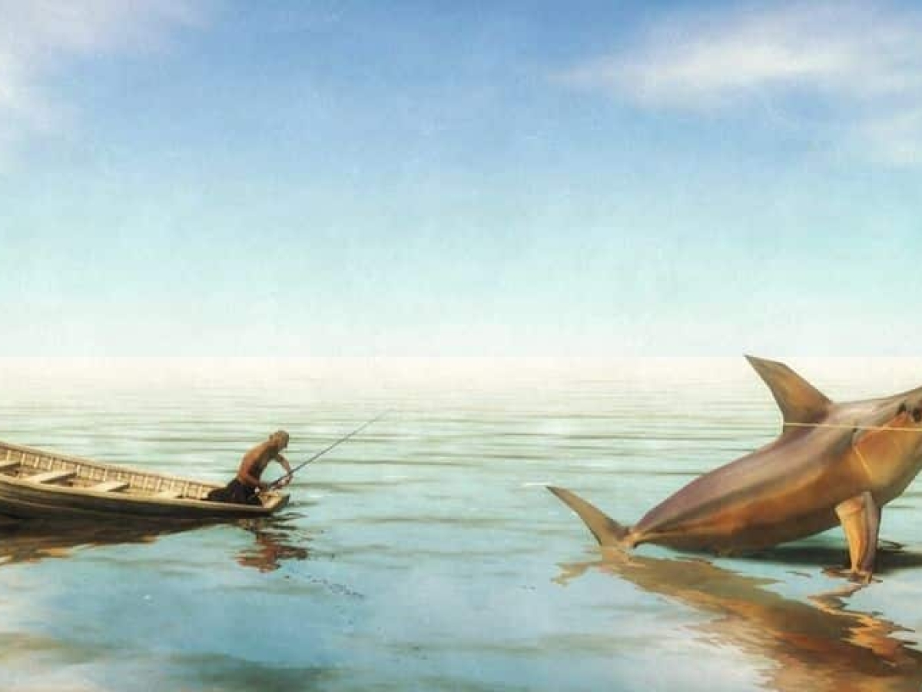



Never give up
Strength comes in many forms
Value effort over outcome
Santiago’s Legacy
Lessons from Santiago

Slide 5

Thank You

